Slide 1




A Comparative Study of How Hyperparameters Affect PPO and SAC Agents for Autonomous Lunar Landing
Reinforcement Learning Lab CA · Mini Project
By
Girish Chaudhari (16010123125) Atharva Patil (16010124814)
Gurkaran Ahuja (16010123129)
1
Notes:
Introduce the team and the project: a comparative study of how hyperparameters affect two deep RL algorithms, PPO and SAC, on a lunar-landing task. 72 training runs, 432 saved agents, 129,600 test landings, all on one laptop.

Slide 2
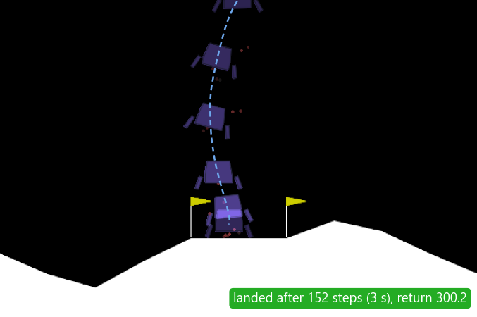
The problem: land on planets the agent cannot see
A lander must touch down gently with a main engine and two side engines. Each landing is on a different planet whose gravity, wind and turbulence are hidden from the agent, so one policy must work on all of them.
2019
2023
0.17 g
Chandrayaan-2's lander was lost in its final descent
Chandrayaan-3 soft-landed near the lunar south pole
on the Moon, 0.38 g on Mars. Our unseen low-gravity planets: 0.2 to 0.4 g
Q1 Which setting matters most?
Q2 Where does performance drop off?
the algorithm, learning rate, network size or training length?
when does more training or a higher learning rate make an agent worse?
The best SAC agent landing in heavy wind (wind 18.8, turbulence 1.75): 3 s, return 300.
Notes:
A lander must touch down gently using a main engine and two side engines, in LunarLanderContinuous-v3 (Gymnasium). Every landing is on a different planet, and its gravity, wind and turbulence are hidden from the agent, so one policy must work on all of them. Training on random planets is domain randomization; testing on low-gravity planets that training never produces measures out-of-distribution generalization.
Motivation: powered descent is the riskiest phase of a landing. The simulator's default gravity of -10 is Earth-like, so the Moon-like planets are exactly the ones training never sees.
The two research questions drive everything that follows.

Slide 3
RL formulation: 8 numbers in, 2 engine commands out
Planet draw
new gravity, wind and turbulence
Component | Our task
Environment | LunarLanderContinuous-v3 (Gymnasium, Box2D, 50 steps/s); a new random planet each landing
State | 8 numbers: position, velocity, angle, angular velocity, 2 leg contacts. No gravity or wind: partially observed
Action | 2 numbers in [−1, 1]: main engine and side engines
Reward | Shaping for getting closer, slower and level, +10 per leg down, a fuel cost; +100 at rest, −100 for a crash. 200 = solved
Discount γ | 0.99
Episode ends | At rest, crash, off-screen, or 1000 steps (20 s)
before each landing
state sₜ
8 numbers
RL agent
policy network π(a | s): PPO or SAC
Environment
LunarLanderContinuous-v3, Box2D, 50 steps/s
action aₜ
2 numbers
reward rₜ
next state
Why reinforcement learning?
No dataset of correct thrust, but a simulator allows safe practice
The decisive reward comes at the end (credit assignment)
One policy can cover a whole range of planets
Learning
PPO: every 2048 steps; SAC: every step, from a replay buffer
updated weights
Notes:
Walk the loop on the left: before each training landing the wrapper draws a new planet; every step (1/50 s) the agent reads the state and outputs the engine commands; the reward and next state feed the learning step.
The state has no gravity or wind in it, so the task is partially observed: the agent has to infer the planet from how it moves.
Why RL: there is no dataset of correct thrust commands, the decisive reward (+100 at rest, -100 for a crash) comes at the end, and classical powered-descent guidance needs an accurate model of the vehicle and the planet.
The next slide gives the exact state ranges, engine thresholds and reward terms.

Slide 4
State, action and reward in detail
# | State variable | Range
1–2 | x, y position relative to the pad | −2.5 to 2.5 (normally −1 to 1)
3–4 | x, y velocity | −10 to 10
5 | angle (radians) | −2π to 2π
6 | angular velocity | −10 to 10
7–8 | left, right leg on the ground | 0 or 1
REWARD PER STEP
rₜ = shapingₜ − shapingₜ₋₁ − 0.3·main − 0.03·side
shaping = −100·distance − 100·speed
− 100·|angle| + 10·(legs down)
Getting closer, slower and more level raises shaping, so it is rewarded every step
Fuel: −0.3 per step at full main throttle, −0.03 for a side engine
Gravity and wind are not in the state: the agent has to infer the planet.
Action | Effect
a₀ main engine | off at ≤ 0; above 0, throttle 50–100%
a₁ side engines | off from −0.5 to 0.5; below −0.5 the left engine fires, above 0.5 the right; throttle 50–100%
AT THE END OF A LANDING
+100
comes to rest
−100
crash, or off-screen (|x| ≥ 1)
A landing that totals 200 or more counts as solved.
Notes:
The values come from Gymnasium's LunarLander source (version 1.2.3).
State: x and y are measured from the pad and scaled so the visible area is roughly -1 to 1; the observation space allows -2.5 to 2.5. Velocities are scaled the same way, the angle is in radians, and the two leg flags are 1 while a leg touches the ground. Gravity and wind are not in the state, so the agent has to infer the planet from how the lander moves.
Action: two numbers in [-1, 1]. The main engine is off at 0 or below and runs at 50-100% throttle above 0. The side engines are off between -0.5 and 0.5; below -0.5 the left engine fires, above 0.5 the right one, again at 50-100%.
Reward: each step pays the change in a shaping term, so moving closer, slowing down and levelling out earn reward, and drifting away gives it back. Firing costs 0.3 per step at full main throttle and 0.03 for a side engine. The landing ends with +100 for coming to rest, or -100 for a crash (the body touches the ground) or leaving the screen (|x| >= 1). A landing that scores 200 or more counts as solved.
Demo D1 (3 s): python -c "import gymnasium as gym; e = gym.make('LunarLanderContinuous-v3'); print(e.observation_space); print(e.action_space)"

Slide 5
Training planets vs test planets
Training
a new planet before every landing
gravity N(−10, 1)
wind |N(0, 7)|, at most 20
turbulence |N(0, 0.7)|, at most 2
Ideal
Moderate wind
Heavy wind
gravity −10 wind 0 turb. 0
gravity −10 wind 5–10 turb. 0.5–1
gravity −10 wind 15–20 turb. 1.5–2
seen in training
seen in training
rarely seen (3% of landings)
Heavy gravity
Low gravity
Random mix
gravity −11 to −11.9 wind 0 turb. 0
gravity −2 to −4 wind 0 turb. 0
gravity −2 to −11.9 wind 0–20 turb. 0–2
seen (14% of landings)
never seen in training
partly seen
300 fixed test planets: 50 per condition, drawn once (seed 2026). Every agent makes one deterministic landing on each.
Notes:
Training: before every landing the wrapper draws a planet from bell curves centred on the default planet; a draw outside the test ranges is drawn again, and the generator is seeded with the run's seed, so each seed always meets the same planets.
Testing: 300 fixed planets, 50 per condition, drawn once with seed 2026 and saved, so every one of the 432 agents is tested on exactly the same planets with a deterministic policy.
Low gravity (-2 to -4) never appears in training, and heavy wind only rarely (3% of training landings).

Slide 6
Two algorithms: PPO vs SAC
PPO
Proximal Policy Optimization
SAC
Soft Actor-Critic
L(θ) = E[ min( rₜ(θ)Âₜ , clip(rₜ(θ), 1−ε, 1+ε) Âₜ ) ]
J(π) = Σₜ E[ rₜ + α H(π(· | sₜ)) ]
On-policy: learns only from fresh experience
Explores by adding noise to its actions
Fast to train: about 0.7 h per run
Sensitive: high learning rates broke big networks
Best agent: 220 return, 85% landed
Off-policy: keeps and reuses past experience
Explores because acting randomly is rewarded
Slow to train: about 5–9 h per run
Robust: never collapsed in our runs
Best agent: 275 return, 96% landed
Why not DQN? It needs discrete actions; the throttles are continuous. Both use Stable-Baselines3 defaults except learning rate and network size.
Notes:
The actions are continuous, which rules out DQN and epsilon-greedy exploration. PPO and SAC are the two main families of deep RL for continuous control: on-policy and off-policy.
PPO: collects 2048 steps, then takes 10 epochs of 32 minibatches of 64 (320 Adam steps) on the clipped surrogate; epsilon = 0.2 is a clip range, not an exploration rate. Its exploration is the learned standard deviation of its Gaussian policy, which falls from 1.0 to 0.12-0.33.
SAC: maximises reward plus alpha times entropy; replay buffer of 1M transitions, batch 256, twin critics with the smaller estimate, target critics with tau 0.005, alpha auto-tuned from 1.0 to 0.04.
Both are Stable-Baselines3's implementations with default hyperparameters apart from the learning rate and network size.
Sources for the bullets: hours per run come from the state files (PPO 0.7 h on average; SAC 4.7-9.1 h depending on network size). PPO's worst setting, 256x256 at lr 3e-3, ends at -968 and lands none; SAC's worst, 16x16 at lr 1e-3, still ends at +78. Best agents after 4000 episodes: SAC 1 (275.1, 96% landed) and PPO 1 (220.4, 85% landed), Table 5 in the report.
Demo D7 (optional): print PPO's action std and SAC's temperature at 125 and 4000 episodes.

Slide 7
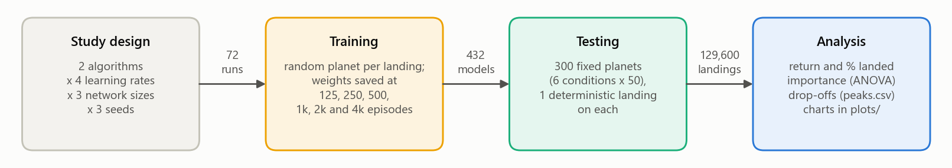
Experiment design: 72 runs, 432 agents, 129,600 landings
ALGORITHM
PPO, SAC
LEARNING RATE
1e-4, 3e-4, 1e-3, 3e-3
NETWORK
16x16, 64x64, 256x256
SEEDS
0, 1, 2
SAVED AFTER (EPISODES)
125, 250, 500, 1k, 2k, 4k
28 h
11
7–13×
≈10 min
to train all 72 runs on one laptop (271 run-hours)
runs at once, one CPU thread each
longer per SAC run than per PPO run
to test all 432 agents
Notes:
A full grid: 2 algorithms x 4 learning rates x 3 network sizes x 3 seeds = 72 training runs of 4000 landings each. Each run saves its weights at 6 stages, which gives 432 agents. Each agent lands once on each of the 300 test planets: 129,600 landings, analysed with return, landed % and an analysis of variance.
Cost: 271 run-hours, about 28 hours of wall-clock time on one laptop (12-13 Oct 2026), 11 runs at once with one CPU thread each. A PPO run took 0.7 h on average and a SAC run 4.7-9.1 h, because SAC updates after every step. Testing all 432 agents took about 10 minutes.

Slide 8
How the code works: three commands
1
72 runs, 11 at a time
2
432 agents × 300 planets
3
charts and analysis
python driver.py train
python driver.py test --log
python driver.py plots
trainer.train() wraps the simulator in GaussPlanetWrapper: a new planet each landing. StageSaver saves the weights at the 6 stages, so a stopped run resumes.
testing.test() flies all 300 landers side by side with one batched, deterministic network call per step: 3.4× faster.
plots.make_plots() draws the charts, runs the analysis of variance (variance_shares()) and finds where each setting peaks.
Our code vs the library
PPO and SAC are Stable-Baselines3's. We wrote the harness: planet randomization, staged saves with an exact resume, batched testing and the analysis.
names.py holds names and paths; diagram.py draws the diagrams.
Engineering challenges
A Windows Update restart killed the first attempt, so runs save at every stage, write files atomically and resume exactly
The GPU was no faster than one CPU thread (30–80 µs per kernel launch), so we trained on 11 CPU workers
Notes:
PPO and SAC come from Stable-Baselines3. The project's own code is the harness around them.
1. python driver.py train: trainer.train() wraps the simulator in GaussPlanetWrapper and builds the model; its StageSaver callback logs every landing and saves the weights at the six stages, so an interrupted run resumes from its last stage.
2. python driver.py test --log: testing.test() and land() fly all 300 planets side by side with one batched, deterministic network call per step, 3.4 times faster than one at a time.
3. python driver.py plots: plots.make_plots() draws the charts, runs the analysis of variance (variance_shares) and finds the peaks.
Demo D2: open trainer.py at GaussPlanetWrapper.reset and StageSaver._on_step, testing.py at the outcome rule, plots.py at variance_shares.

Slide 9
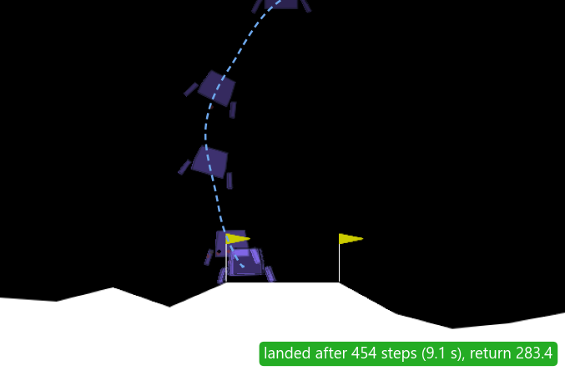
Demo: the best agent on all 300 test planets
SAC 1: SAC, 256x256, lr 3e-3, seed 0, after 4000 episodes
Condition | Mean return | Landed | Crashed | Timeout
ideal | 282.6 | 100% | 0% | 0%
moderate wind | 288.8 | 100% | 0% | 0%
heavy wind | 272.3 | 94% | 4% | 2%
heavy gravity | 282.7 | 100% | 0% | 0%
low gravity | 259.1 | 90% | 6% | 4%
random mix | 273.8 | 98% | 2% | 0%
all 300 | 276.6 | 97% | 2% | 1%
Heavy wind (18.8): lands in 3 s
Low gravity (−2.73), never trained on: hovers, lands in 9.1 s
Reliable inside its training range: 98–100% landed in ideal, both winds and heavy gravity
Low gravity is its weak spot: 90% landed for this seed, slower and hovering
Every watched landing matches its logged test result
Watch it live:
python testing.py resources/sac/sac_lr3e-3_net256x256_seed0_ep4000.zip
--render --conditions heavy_wind
Notes:
This is Output 1 in the report: the best single agent, SAC 1 seed 0, tested on all 300 planets. It lands 97% of the time overall, 94% in heavy wind and 90% in low gravity, which it never trained on.
Demo D6 (12 s, no window): python testing.py resources/sac/sac_lr3e-3_net256x256_seed0_ep4000.zip
Demo D4 (live landings; Ctrl+C after 2-3): python testing.py resources/sac/sac_lr3e-3_net256x256_seed0_ep4000.zip --render --conditions heavy_wind (then --conditions low_gravity). Heavy wind: landing 1 lands in about 3 s, landing 2 crashes (one of its 4%). Low gravity: landings 1-3 land but take 6-9 s each; point out the hovering.
Set $env:OMP_NUM_THREADS = 1 first so the numbers match the report exactly. Never add --log during the demo.

Slide 10
Best settings: SAC wins, and SAC 4 is the bargain
SAC 1
275.1
PPO 1
220.4
SAC 4
264.3
mean return · 96.2% landed
SAC, 256x256, lr 3e-3, 4000 episodes
mean return · 85.0% landed
PPO, 256x256, lr 1e-4, 4000 episodes
in ≈2.0–2.6 h, vs 9.1–10.1 h for SAC 3 (264.8)
SAC, 64x64, lr 3e-3, 2000 episodes
Rank | Setting | Mean return | Seed range | Landed % | Steps per run | Hours per run
SAC 1 | SAC, 256x256, lr 3e-3 | 275.1 | 273.8–276.6 | 96.2 | 0.83–0.92 M | 8.1–9.8
SAC 2 | SAC, 256x256, lr 1e-3 | 271.4 | 262.7–277.9 | 96.0 | 0.90–0.94 M | 8.8–9.1
SAC 3 | SAC, 256x256, lr 1e-4 | 264.8 | 258.0–270.3 | 95.3 | 1.10–1.24 M | 9.1–10.1
SAC 4 | SAC, 64x64, lr 3e-3 (2000 episodes) | 264.3 | 255.1–272.8 | 93.0 | 0.62–0.77 M | ≈2.0–2.6
PPO 1 | PPO, 256x256, lr 1e-4 | 220.4 | 214.9–223.7 | 85.0 | 1.71–1.88 M | 0.8–1.0
PPO 2 | PPO, 256x256, lr 3e-4 | 212.3 | 197.0–234.2 | 85.5 | 1.53–1.56 M | 0.8–0.9
PPO 3 | PPO, 64x64, lr 1e-4 | 209.3 | 191.6–229.5 | 79.5 | 1.76–1.91 M | 0.8–0.9
Notes:
A setting is one algorithm, learning rate and network size; its result is the mean of its 3 seeds.
SAC 1 (256x256, lr 3e-3) reaches a mean return of 275.1 and lands 96.2% of the time; PPO 1 (256x256, lr 1e-4) 220.4 and 85.0%. The winners' seed ranges do not overlap (SAC 1: 273.8-276.6; PPO 1: 214.9-223.7), so the gap is not seed luck. Ranking by landed % picks the same settings, only PPO 1 and 2 swap.
SAC 4, 64x64 at lr 3e-3, peaks after 2000 episodes at 264.3, level with SAC 3 (264.8) in about a quarter of the training time: 2.0-2.6 hours against 9.1-10.1. Its hours are estimated from the share of each run's steps done by 2000 episodes.

Slide 11
Test return vs training episodes, per learning rate
PPO with lr ≥ 1e-3 on 64x64 or 256x256 collapses; SAC above 16x16 improves at every learning rate. Each line: mean of 3 seeds.
lr 1e-4
lr 3e-4
lr 1e-3
lr 3e-3
solved (200)
Notes:
Each panel is one algorithm and network size; each line one learning rate, the mean of its 3 seeds, tested on all 300 planets. The x axis doubles at each stage: 125 to 4000 training episodes.
Top row, PPO: on 64x64 and 256x256, lr 1e-3 and 3e-3 collapse. 64x64 at lr 3e-3 peaks at 250 episodes and ends at -187; 256x256 at lr 1e-3 is healthy at 2000 episodes (169) and ends at -355; 256x256 at lr 3e-3 never learns (-968). 16x16 tolerates every learning rate and learns fastest with a high one (126 after 500 episodes with lr 1e-3, against -277 with lr 1e-4), but never reaches 200.
Bottom row, SAC: 64x64 and 256x256 improve at every learning rate; the lines bunch together, so SAC is insensitive to the learning rate there. SAC 16x16 depends more on its seed than on its learning rate.
The report's Figure 5 is the same data with a band from the worst to the best seed.
Demo D3: PPO 1's best seed at 125, 500 and 4000 episodes (crash, hover, land).

Slide 12
Landing success vs training episodes, per learning rate
The same split on a bounded measure: SAC 64x64 and 256x256 end at 88–96% landed, PPO at most 86%.
lr 1e-4
lr 3e-4
lr 1e-3
lr 3e-3
Notes:
The share of the 300 test landings that came to rest, per setting (mean of 3 seeds).
Landed % is bounded between 0 and 100, so the PPO collapses do not stretch the axis the way they do for return. All eight SAC 64x64 and 256x256 settings beat the best PPO setting: 88-96% landed against at most 86%.
From 125 to 4000 episodes, SAC 1 rises from 25% to 96% landed and PPO 1 from 0% to 85%.
The report's Figure 6.

Slide 13
Training return vs training episodes, per learning rate
The collapses happen during training too, on random planets with exploration on, so they are not a testing artefact.
lr 1e-4
lr 3e-4
lr 1e-3
lr 3e-3
solved (200)
Notes:
Training return: the mean of the last 100 training landings at each stage, each on a new random planet with exploration on. Mean of 3 seeds.
The same PPO settings collapse here as in testing, so the collapse is in the policy itself, not an effect of the deterministic test. SAC's training return tracks its test return closely.
The report's Figure 4.

Slide 14
F1 · SAC wins per episode and per sample, not per hour
MEAN TEST RETURN
LANDED
Per episode: the best PPO setting (220, 85% landed) only matches the average SAC setting (218, 82%).
Per sample: SAC 1 needs about half of PPO 1's environment steps.
Per hour: a SAC run takes 7–13× as long, since it updates after every step. Early on PPO is the more efficient: 179 (73% landed) after 1000 episodes in ≈17 min, against ≈24 min for SAC 64x64 to reach 160. Later the two are about even (34 vs 43 min).
SAC 1
275.1
SAC 1
96.2%
PPO 1
220.4
PPO 1
85.0%
ENVIRONMENT STEPS PER RUN
TRAINING HOURS PER RUN
SAC 1
0.83–0.92 M
SAC 1
8.1–9.8
So: SAC wins per episode and per sample, never per hour. The budget was equal episodes, not equal compute.
PPO 1
1.71–1.88 M
PPO 1
0.8–1.0
Notes:
Per episode: the best PPO setting (220, 85% landed) only matches the average SAC setting (218, 82%), and all eight SAC 64x64 and 256x256 settings beat it.
Per sample: SAC 1 used about half PPO 1's environment steps (0.83-0.92 M against 1.71-1.88 M).
Fairness: the budget was equal episodes, not compute. A SAC run took 7-13 times as long because it updates after every step. Per estimated CPU-minute PPO is the more efficient early on: 256x256 at lr 1e-4 reaches 179 (73% landed) after 1000 episodes in about 17 minutes, while SAC 64x64 at lr 3e-3 needs about 24 minutes to reach 160. Later the two are about even: 34 minutes for that PPO setting to reach 201, 43 for that SAC setting to reach 206.

Slide 15
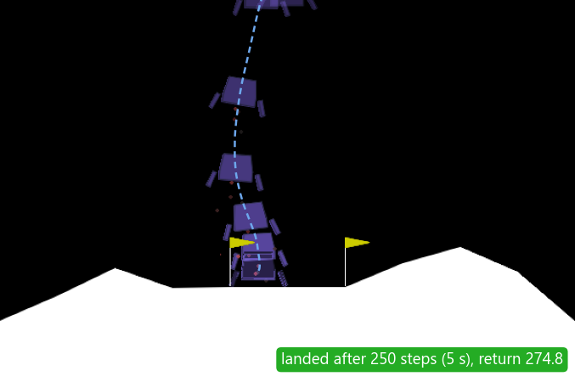
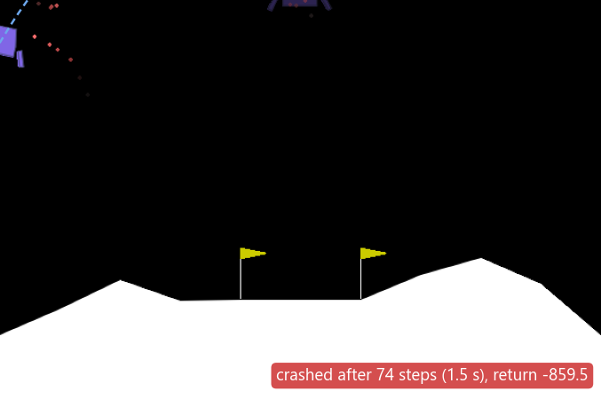
F2 · PPO has a learning-rate cut-off and can collapse late
A cut-off, not a trend: lr ≥ 1e-3 breaks PPO on every network above 16x16 (−968 to 83); 1e-4 and 3e-4 reach 175–220.
16x16 tolerates every lr (113–161) and learns fastest with a high one, but never reaches 200.
Evidence: the lr 3e-3 256x256 policies output mean actions up to 58 (valid: ±1), so 99–100% of actions are clipped; their action std grew from 1.0 to 1.6–3.2.
Likely cause: 320 Adam steps per batch at a high constant lr; the clip is no trust region, and an on-policy agent only learns from its own broken behaviour.
SAC stays stable (likely): replay buffer, slow target critics, twin critics, entropy bonus and tanh-squashed actions damp a bad update.
After 2000 episodes: lands in 5 s, return 275
Same run after 4000: off-screen crash in 1.5 s, return −860
169 → −355
mean test return of PPO 256x256 at lr 1e-3, after 2000 → 4000 episodes (72% → 4% landed)
Notes:
Point at the two pictures: the same PPO run, 256x256 at lr 1e-3, lands cleanly after 2000 episodes and flies off the screen within 1.5 s after 4000. A study that stopped at 2000 episodes would pick it.
Likely cause (not measured directly): with a constant high learning rate each update makes 320 Adam steps on one batch, and wider layers add up more of these moves. The clip only stops the gradient for samples already outside 0.8-1.2, so it does not enforce a trust region. Once the mean action is far outside [-1, 1], almost every action is clipped to the same edge and the advantages no longer point the way back; being on-policy, a broken policy only collects data from its own broken behaviour.
Evidence: on 60 test planets the three lr 3e-3 256x256 policies output mean actions of median size 4-51 and up to 58, so 99-100% of their actions are clipped, and their action std grew to 1.6-3.2.
Demo D5: python testing.py resources/ppo/ppo_lr1e-3_net256x256_seed1_ep2000.zip --render --conditions ideal, then the same with ep4000.

Slide 16
F3 · What matters most depends on the measure
Mean return
Landed %
Mean return without the unstable PPO corner
By landed %, which is bounded, training length matters most: 40%.
By mean return, PPO collapses near −1000 dominate: combinations explain 45% and seed luck 23%. The unstable corner (PPO, lr ≥ 1e-3, 64x64 or 256x256) is 17% of the agents.
Without that corner, training length explains 49%, and network size rises from 1% to 10.5%: two opposite effects had cancelled out.
Among the 72 final agents, the algorithm matters most (21% of landed %).
η²: each setting's share of the spread between all 432 agents (%)
Notes:
A four-way analysis of variance gives each setting's share, eta squared, of the total spread between the 432 agents; what is left between the 3 seeds of the same settings is seed luck.
By mean return, training length and the algorithm lead the single settings at 12% each, but combinations explain 45% and seed luck 23%, mostly because of the unstable PPO corner (lr 1e-3 or 3e-3 on 64x64 or 256x256, 17% of the agents). Its returns near -1000 dominate the squared spread and cause 72% of the seed-luck share.
By landed %, which is bounded, training length matters most: 40%. Without the unstable corner it explains 49% of the spread in return, and network size rises from 1% to 10.5%: inside the corner a bigger network is worse and elsewhere better, so the two effects cancelled out.
Among the 72 final agents the algorithm matters most (21% of the spread in landed %).

Slide 17
F4 · Generalization: low gravity is the hardest
SAC 1 (SAC, 256x256, lr 3e-3)
PPO 1 (PPO, 256x256, lr 1e-4)
Low gravity, never seen in training, is hardest: across all settings SAC lands 61% there vs 80–90% elsewhere, PPO 42% vs 46–68%.
PPO crashes, SAC hovers: SAC 1 times out on 10% of low-gravity landings. Likely, without gravity in its state, Earth-like thrust lifts it too much.
Heavy wind widens SAC's lead: PPO 1 drops from 93% to 81% landed, SAC 1 from 100% to 98%.
More training can over-specialize: SAC 64x64, lr 3e-3 loses 20 points from 2000 to 4000 episodes, almost all in low gravity (233 → 164).
Landed % per test condition after 4000 episodes (150 landings each: 50 planets × 3 seeds)
Notes:
Landed % per test condition for the two winners, after 4000 episodes; 150 landings each (50 planets x 3 seeds).
Low gravity, which training never produces, is the hardest condition: across all settings at 4000 episodes SAC lands 61% there against 80-90% elsewhere, and PPO 42% against 46-68%, and training helps least there. Likely, the agent cannot tell which planet it is on (gravity is not in the state and the network has no memory), so thrust learned for Earth-like gravity lifts it too much and it hovers.
PPO crashes, SAC hovers: PPO 1's failures are nearly all crashes (14.2% crashed, 0.8% timed out); SAC 1 times out on 10% of low-gravity landings.
Heavy wind widens SAC's lead and rewards training most: the average SAC setting gains 298 points there from 125 to 4000 episodes, against 262 in ideal.
More training can over-specialize: SAC 64x64 at lr 3e-3 loses 20 points from 2000 to 4000 episodes, almost all in low gravity. With one setting and 3 seeds it is a sign, not proof.

Slide 18
Conclusion
SAC beats PPO per episode and per sample: 275 and 96% landed vs 220 and 85%, with non-overlapping seed ranges.
Limitations
Only 3 seeds per setting; only lr and network size varied
Equal episodes, not equal compute; most settings not converged
A 2-D simulator; F2 and F4 explanations are likely, not proven
1
A cheaper setting, SAC 64x64 at lr 3e-3, matched SAC 3 after 2000 episodes in about a quarter of the training time.
2
PPO needs lr ≤ 3e-4 above 16x16 and can collapse late; SAC is insensitive to the learning rate at 64x64 and 256x256.
3
Future scope
Train on to 8000 episodes with more seeds; log PPO's KL and clip fraction
PPO with a learning-rate schedule or a KL target
Low gravity in training, the planet in the state, or a recurrent network
What matters most depends on the measure: without the unstable PPO corner, training length explains about half the spread.
4
Low gravity, never seen in training, is the hardest condition.
5
Notes:
Close with the answers to the two research questions. Which setting matters most: it depends on the measure; by landed % and without the unstable PPO corner, training length. Where performance drops off: only for PPO with a high learning rate on a bigger network; 18 of the 24 settings were still at their best at 4000 episodes.
Limitations: only 3 seeds per setting; only the learning rate and network size were varied; equal episodes, not equal compute; most settings had not converged by 4000 episodes; a 2-D simulator with unlimited fuel; the explanations in F2 and F4 are likely, not proven, because PPO's KL divergence and clip fraction were not logged.

Slide 19
Thank You
Questions?
Notes:
Invite questions. Backup slides follow: every setting after 4000 episodes, and the hyperparameters. The viva questions to prepare are in submit/report plan.md.

